Slide 1

SAFERIDE
Your Safety, Our Priority
Developer Handoff & Demo
Figma Dev Mode Handoff · Design Tokens · Product Walkthrough
Prepared by Arnib · Version 1.0

Slide 2
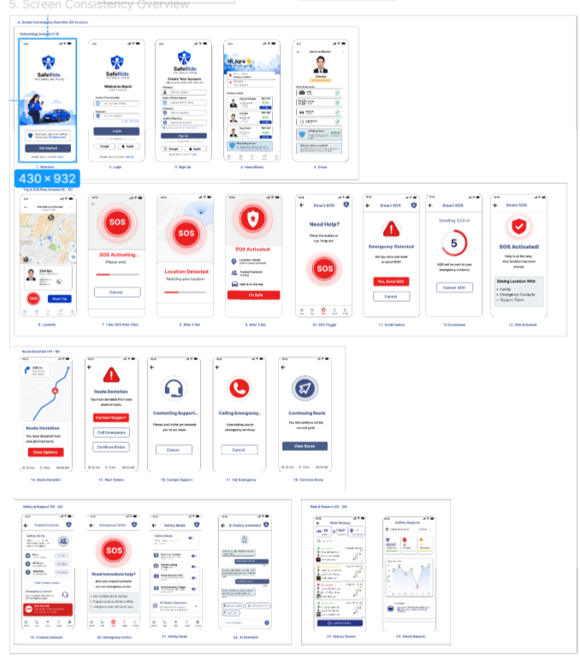
OVERVIEW
What's in this Deck
1
Product Demo
A quick walkthrough of the SafeRide app — 24 screens across onboarding, SOS, and safety flows.
2
Component Specification
Exact measurements, states, and styling for shared components (e.g. Primary Button).
3
Design Tokens
The color, typography, and spacing values engineering should reference directly.
4
Handoff Notes & Naming
Rules for Figma Dev Mode, layer naming, and shared component usage.
02

Slide 3
PART 1 — DEMO
Product Walkthrough — 24 Screens
Onboarding
1
5 screens
Welcome, login, sign-up, home & driver verification
Trip & Smart SOS Flow
2
8 screens
Live trip tracking through full SOS activation sequence
Route Deviation
3
5 screens
Alert, contact support, call emergency, continue route
Safety & Support
4
4 screens
Trusted contacts, emergency center, safety mode, AI assistant
Ride & Reports
5
2 screens
Ride history and AI-driven safety reports
03

Slide 4
PART 2 — DEVELOPER HANDOFF
Component Specification
PRIMARY BUTTON — “Book Ride”
PREVIEW
Component name
Button / Primary
Book Ride
Width / Height
Fill container / 48px
Default
Padding
16px horizontal
Book Ride
Corner radius
8px
Font
Inter · 14px · SemiBold
Pressed
Text color
#FFFFFF
Book Ride
Background
#1E3A8A
Disabled
States
Default · Pressed · Disabled
Use Figma Dev Mode to inspect exact measurements for every component in this file.
04

Slide 5
PART 2 — DEVELOPER HANDOFF
Design Tokens — Color
Primary
Emergency
Warning
Safe
Background
Text Primary
Text Secondary
#1E3A8A
#E53835
#F88C00
#43A047
#F5F6F8
#111827
#687280
TOKEN USAGE RULES
✓
Reference tokens by name, never hard-code hex values in components.
✓
Emergency red is reserved exclusively for SOS / critical actions.
✓
Warning yellow is used for alerts and route-deviation states only.
✓
Primary blue covers navigation, headers, and non-emergency buttons.
05

Slide 6
PART 2 — DEVELOPER HANDOFF
Typography & Spacing Tokens
TYPOGRAPHY — Inter
SPACING — 8px Grid
Aa
H1
24px / Bold
4px
8px
16px
Aa
H2
20px / SemiBold
Micro
Small
Base
Aa
H3
16px / SemiBold
24px
32px
48px
Medium
Large
Extra Large
Aa
Body
14px / Regular
Aa
Caption
12px / Regular
Font family: Inter — consistent across all screens. Never mix more than 2 fonts on one screen.
Keep all layout spacing on the 8px grid — 4px is reserved for micro adjustments only.
06

Slide 7
PART 2 — DEVELOPER HANDOFF
Developer Handoff Notes
1
Use Figma Dev Mode for exact measurements
2
Keep component and layer names clear and consistent
3
Use shared color and typography tokens
4
Keep 8px grid spacing across all layouts
5
Use unified button, card, and icon components
6
Emergency red is reserved for SOS / critical actions
7
Warning yellow is used for alerts and route deviation
8
Verify all interactive states before development
07

Slide 8
NAMING CONVENTIONS
Consistent Layer & Component Naming
Button/Primary
Button/Danger
Card/Driver
Card/Safety
Icon/SOS
PATTERN
Category / Variant
Every component, card, and icon follows this pattern so engineers can map Figma layers directly to code components — no guessing, no duplicate variants.
08

Slide 9
✓
HANDOFF READY
Figma file is structured, tokens are documented, and components are named for a clean engineering handoff.
Questions? Reach out to Arnib, Safa & Iqra.

